Slide 1



RSG – Turkey 2021 Student Symposium Command Line Basics
Eda Şamiloğlu

Slide 2
Command Line Basics
Command is a specific input type; “Show me all my files!”
Command line is the current line within the terminal which can be used to input text commands.
The command line allows users to run a vast range of commands and includes facilities to run successive commands as one single operation, with the output of one command fed directly into the next.
It is also the starting point for running most bioinformatics software.

Slide 3
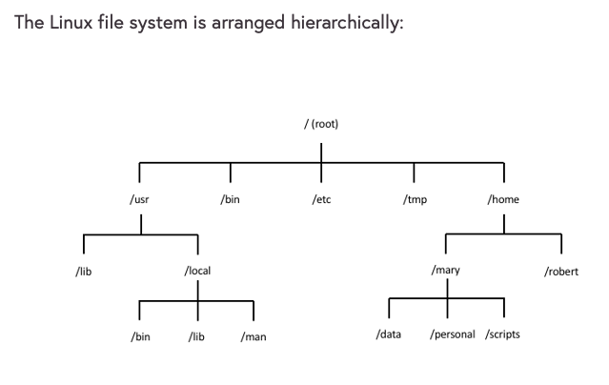


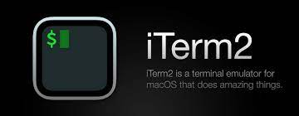
Directories and Files
In the operating systems, information is stored in files.
Open your terminal or an online cloud shell!
Your file organization
might be different

Slide 4
Directories and Files
In Linux, as with other operating systems, information is stored in files.
pwd:
The pwd command displays (“prints” to the screen) the current working directory.
whoami:
Displays your logged in user id.

Slide 5
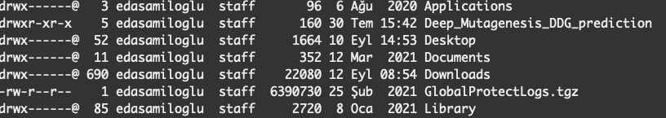
Changing the current directory
ls: Directory listing.
ls –l: long version

Slide 6
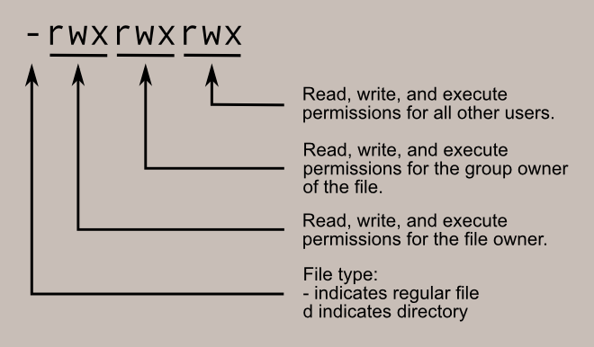
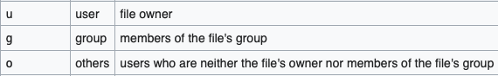
Changing the current directory
ls –l: long version
chmod: used to change the access permissions of files and directories, known as modes.
chmod o+w GlobalProtectLogs.tgz

Slide 7
Changing the current directory
cd: Change current working directory.
cd Desktop/
pwd
cd ..
Then
List existing file and directories, ls
cd : Back to home directory.
pwd

Slide 8
Clear the terminal screen and explore man
clear: Clear the terminal screen.
man: Man pages, the user manual.
man clear

Slide 9
Create a directory and using text editor nano
mkdir: The mkdir command creates a directory.
mkdir Command_Line_Basics
cd Command_Line_Basics
mkdir example
cd example
ls
touch file
open file
nano file
name: Eda
surname: Şamiloğlu
workshop: RSG-Turkey Command Line Tools
session name: Command Line Basics

Slide 10
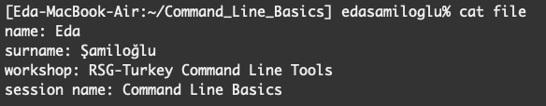
Display file content
cat : The cat utility reads files sequentially, writing them to the standard output.
cat file

Slide 11
Copy and Move files
cp: Copies the contents of the source-file to the target-file.
mv: move files and directories from one directory to another or to rename a file or directory.

Slide 12
Combining command lines
cp file first_nano_experience
mv first_nano_experience ..
rm file
ls
cd ..
rmdir example (rm –r)

Slide 13
Working with FASTA file - sequence.fasta
wget https://raw.githubusercontent.com/rsgturkey/Workshop2021/main/Command_Line_Basics/sequence.fasta .
cp sequence.fasta sequence.fasta_copy
ls
ls –l
ls -lrt

Slide 14
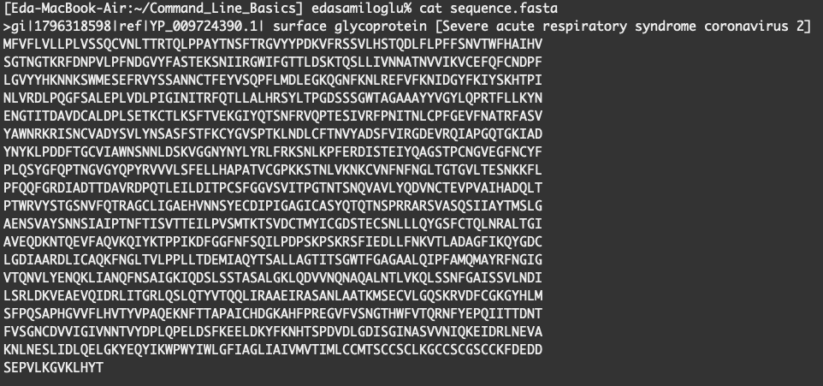
Working with FASTA file - sequence.fasta
cat sequence.fasta
nano sequence.fasta

Slide 15
Working with FASTA file - sequence.fasta
mv sequence.fasta surface_glycoprotein
head surface_glycoprotein
head -1 surface_glycoprotein
tail surface_glycoprotein

Slide 16
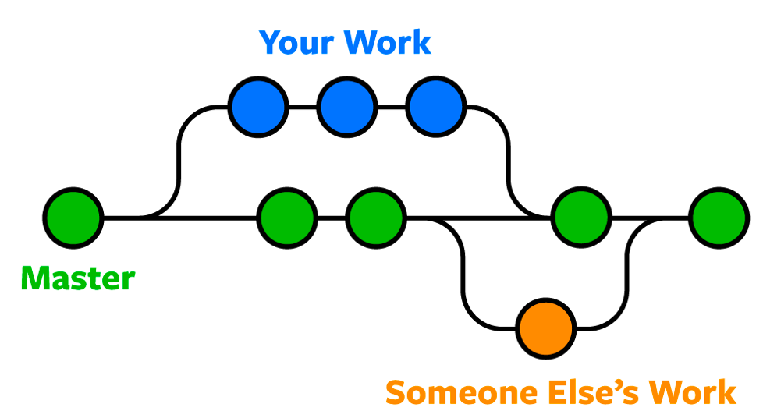
Bonus: git version control
Git is the most commonly used version control system.

Slide 17
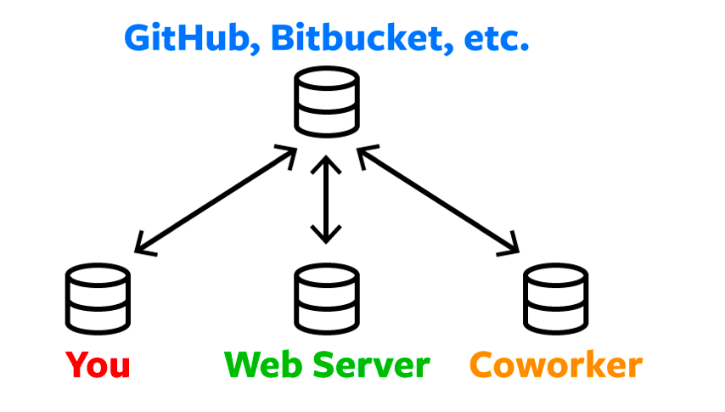
Bonus: git version control
Storing a copy of your Git repo with an online host (Github or Bitbucket)
There are a lot of different ways to use Git.
There are the original command-line tools, and there are many graphical user interfaces of varying capabilities.

Slide 18
Bonus: git version control via terminal
mkdir my_project
cd my_project/
cp ../surface_glycoprotein .
ls
git init:
ls -la
git add: The command used to add a file that is in the working directory to the staging area.
git add surface_glycoprotein

Slide 19
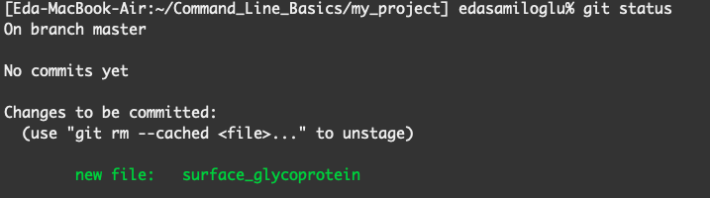
Bonus: git version control
git status: Lists all new or modified files to be committed
git commit -m "new file added"

Slide 20
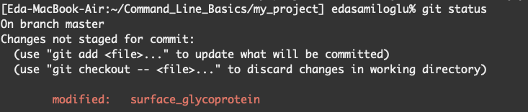
Bonus: git version control
nano surface_glycoprotein and remove first line
git diff
git checkout
To save changes:

Slide 21
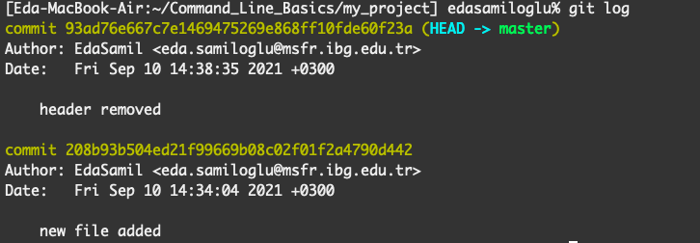
Bonus: git version control
git log: To see the history of commit you made to your files.

Slide 22

Bonus: git version control via GitHub
GitHub, is a provider of internet hosting for version control using Git.

Slide 23

Bonus: git version control via GitHub

Slide 24
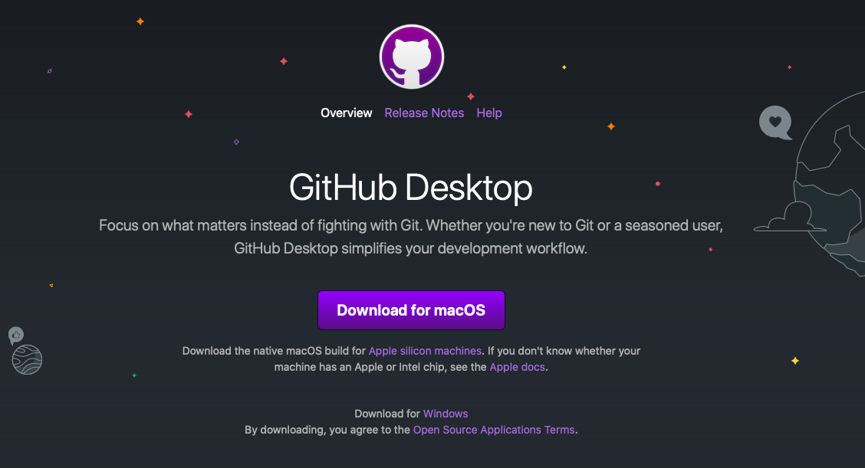
Bonus: git version control GitHub Desktop

Slide 25


Slide 26
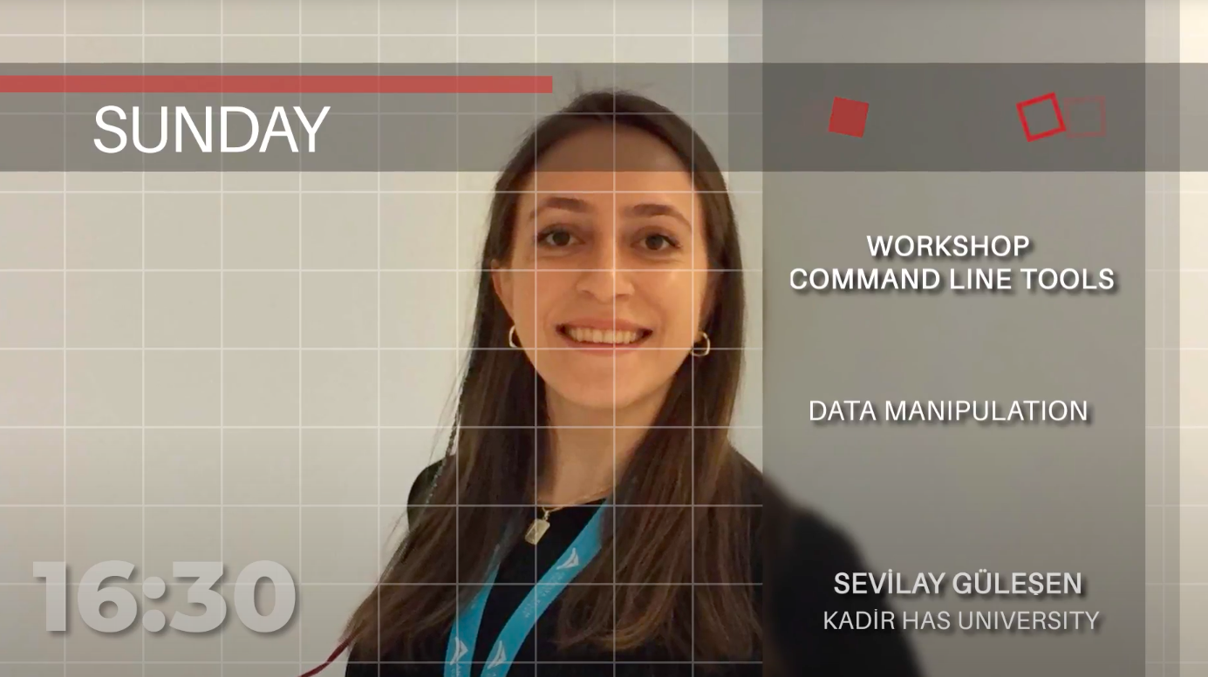

Slide 27

https://www.futurelearn.com/courses/linux-for-bioinformatics

